Slide 1
COVID-Tracking
Sultan Abdalla Salim Saif Alteneiji, Justin Andrews, Bryce Cole, Jonah Corbin

Slide 2
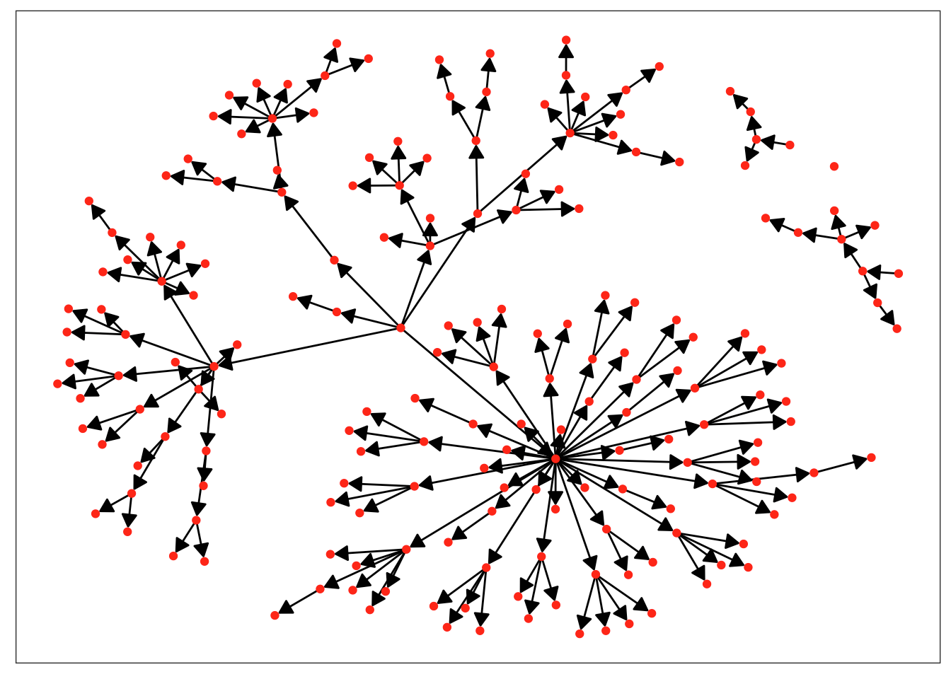
Introduction
Our app aims to help slow the spread of COVID-19 using Dunbar’s social brain hypothesis and social media data.
Dunbar's social brain hypothesis theorizes that humans can only maintain relationships with a fixed number of other humans.
This relationship can be modeled in an exponential fashion, where 3 or 4 people make up the majority of interactions.
Our app uses social media data to group the people you interact with. If you test positive for COVID the app helps you decide who you have had contact with recently.

Slide 3
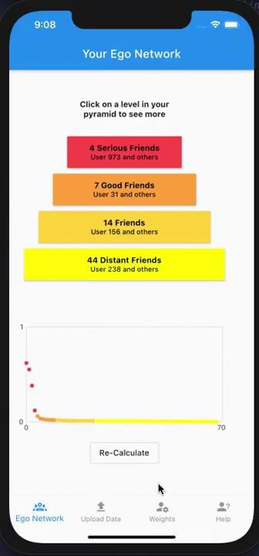
Video Demo

Slide 4
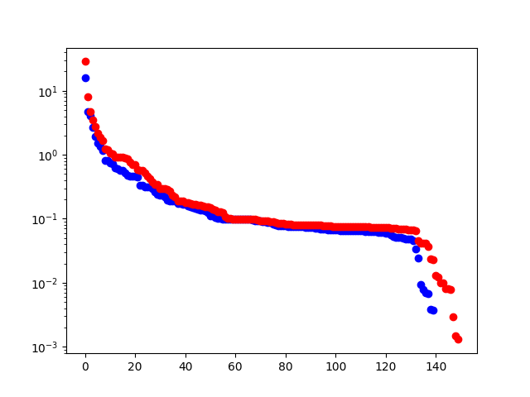
Individual Contribution - Bryce
Algorithm Contribution
Mobile App Contribution
Designed the python prototype algorithm.
Created the parsing framework.
Implemented Instagram and Snapchat parsers.
Integrated algorithm in app.
Created the weight page to allow users to change weights in-app.
Was responsible for code that handles storage, formatting and retrieval of data flowing through the app.
Created the people list page that shows when clicking on a layer.
Created the data source manager which allows you to add and view different data sources.
Added the result graph to the results display to allow more advanced users to better visualize their data.

Slide 5
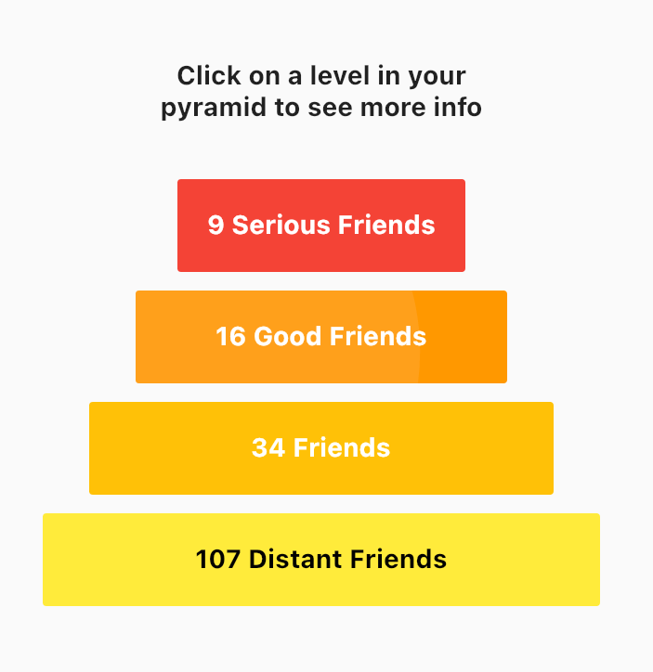
Individual Contribution - Jonah
Developed the pyramid part of the algorithm result page
Helped develop navigation logic
Helped develop the facebook parser
Contributed to bug updates

Slide 6
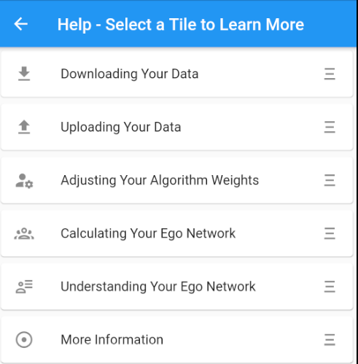
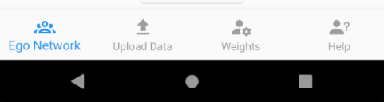
Individual Contribution - Justin
Navigation Bar:
Modularized our code from the first sprint.
Created the Navigation Bar which served as the outline for how the pages of our app are organized.
Help Page:
Created the Help Page.
Documentation:
Was lead on documentation.

Slide 7
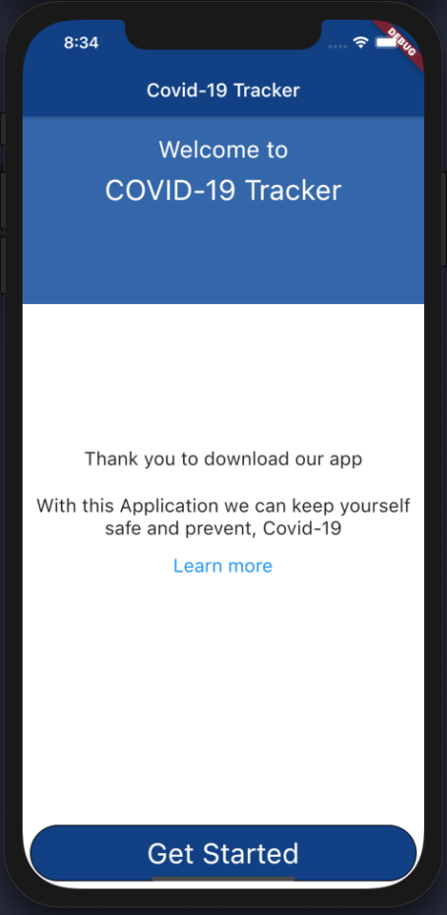

Individual Contribution - Sultan
Launching Screen:
Home Page
Learn More
Positive
Negative
Get Started
Icon Application:
Create an icon for the application

Slide 8
Sprint Retrospective
We accomplished everything we set out to do at the beginning of the semester and the app is fully functional. Next semester there are many feature upgrades we really think could take the app to the next level in both usability and power.
AI based level classifier.
Location based data sources.
Content aware data sources.
A scoring metric to judge different iterations of the algorithm.
Improvements to app help pages and useability.
Add sharing feature.
Notes:
What is left to do for next spring
Show scrum board
Major goals if this project were to be continued in the fall by a team

